Slide 1
M-Enabling: A New Paradigm for Persons with Disabilities CSUN 2012 San Diego February 29, 2012 Axel Leblois Francesca Cesa Bianchi G3ict
Notes:
This presentation will cover the main areas of our joint report with ITU-D developed in cooperation with the Center for Internet and Society.

Slide 2
Mobile Users: More Users in 2012 than Human Beings on the Planet
2011: 5.9 billion mobile subscribers - 87 percent of the world population
Growth is led by China and India, which account for over 30 percent of world subscribers
Smartphones showing strongest growth in 2011
Android is now the top smartphone operating system

Slide 3
Key Data Points: Mobile Broadband
 | Global | Developed nations | Developing nations | Africa | Arab States | Asia & Pacific | CIS | Europe | Ame- ricas
Active mobile broadband subscriptions 2011 (millions) | 1,186 | 701 | 484 | 31 | 48 | 421 | 42 | 336 | 286
Per 100 people 2011 | 17.0% | 56.5% | 8.5% | 3.8% | 13.3% | 10.7% | 14.9% | 54.1% | 30.5%
Active mobile broadband subscriptions 2010 (millions) | 870 | 569 | 301 | 20 | 36 | 289 | 31 | 254 | 224
Per 100 people 2010 | 12.6% | 46.2% | 5.3% | 2.5% | 10.2% | 7.4% | 11.2% | 41.3% | 24.1%
Source: International Telecommunication Union (November 2011)

Slide 4
Top 10 Countries for Active Mobile Broadband Subscriptions
Rank | Country | Percentage | Rank | Country | Percentage
1 | Korea (Rep.) | 91.0 | 6 | Hong Kong, China | 74.5
2 | Japan | 87.8 | 7 | Portugal | 72.5
3 | Sweden | 84.0 | 8 | Luxembourg | 72.1
4 | Australia | 82.7 | 9 | Singapore | 69.7
5 | Finland | 78.1 | 10 | Austria | 67.4
Source: ITU and Wireless Intelligence (2011)

Slide 5
Why Mobile Matters?
One billion persons live a disability worldwide (WHO – World Bank Report on Disabilities)
Convention on the Rights of Persons with Disabilities – Signed by 153 countries, ratified by 110
Article 9 on accessibility
New ecosystem with new players, new challenges and opportunities

Slide 6
The New Mobile Accessibility and Assistive Technologies Ecosystem
Mobile service providers
Organizations of persons with disabilities and seniors users
Application developers
Handset manufacturers, operating systems, middleware vendors
Mobile devices accessories and peripherals
Telecom regulators and policy makers
Cloud-based solution providers
Information services, e-government and e-commerce providers
Remote services for seniors and persons with disabilities

Slide 7
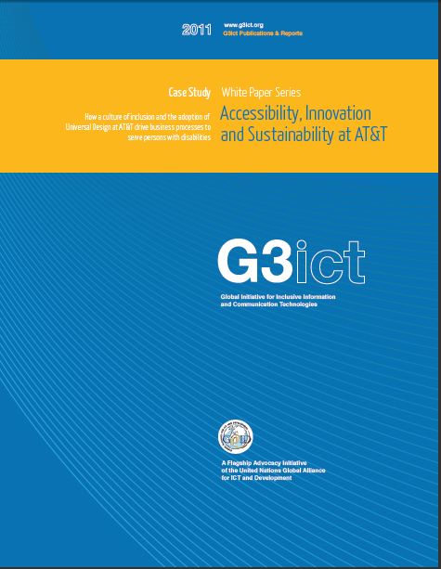
AT&T Case Study by G3ict – March 2011 Universal Design, Customer Services
Universal Design
AAPAA: involving persons with disabilities in designing products and services
Dedicated marketing
Special rate plans
Customer service
160,000 employees trained on disability and accessibility issues

Slide 8
Trend of Cell Phone Usage Rates by Age in Japan: NTT DoCoMo Raku Raku Success Story
04-08: over-50 age bracket usage growth has been remarkable
（％）
Source: NTT presentation at 2009 ITU-G3ict Bangkok meeting, Report on Trends in Communications Use, Ministry of Internal Affairs and Communications (MIC)
Notes:
This graph shows the trends of the mobile phone usage rate by age.
Tow distinct characteristics can be seen from this graph.
One is that Japanese total mobile phone market is trending toward saturation.
The other is that the over-50 age bracket in particular shows remarkable growth.
Given this circumstance, over the age of 50 market seems to be a very attractive for us.
So, we believe it’s important to offer a rich lineup of mobile phones for seniors to choose from.

Slide 9
M-Enabling Summit: Bringing Ecosystem Participants Together
To promote the awareness and implementation of accessible and assistive mobile solutions for seniors and persons with disabilities by sharing technologies, processes, policies and business models among stakeholders from around the world

Slide 10
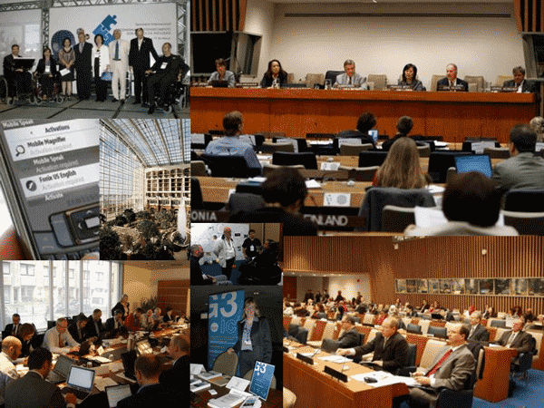

Slide 11
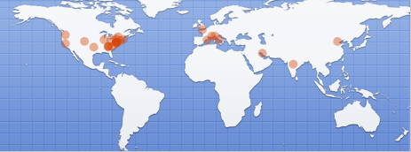
M-Enabling Summit 2011 Participants from 32 Countries
372 Conference Participants
170 Showcase Visitors
Major Mobile Service Providers participation
In collaboration with the FCC and ITU

Slide 12
Innovation Drivers for Mobile Assistive Technologies
Handset based technology
Text to Speech, voice recognition
Scanner capability
GPS – triangulation and indoor beacon positioning
Remote services
Emergency services
Digital libraries
Video Relay Services
Blue tooth proximity services
Cloud based technologies
Already used by mobile operators for heavy processing voice assistive apps
Offers limitless opportunities for other assistive applications but requires bandwidth and limited latency
Notes:
As noted earlier, the mobile platform offers not only accessibility features but also assistive technologies which can directly address the need of persons with specific

Slide 13
M-Enabling Summit Key Findings
Mobile Enabling Technologies and economies of scale offer unprecedented opportunities for Persons with Disabilities
Innovative business models and distribution channels for assistive solutions
Leading service providers fully engaged in promoting solutions
CRPD promotes policy and regulatory activity worldwide
Universal Service Funds address Mobile services for Persons with Disabilities

Slide 14
Mobile Accessibility on the Move
48% of State Parties to the CRPD have policies on accessibility of mobile phones
Middle income economies ahead:
High income economies = 18%
Upper middle income economies = 67%
Lower middle income economies = 75%
Low income economies = 50%
Reflect importance of mobile and policies in support of PWDs in middle income economies
Source: 2010 G3ict Survey of the implementation of the CRPD ICT accessibility dispositions by ratifying countries

Slide 15
M-Enabling Summit
2012 - 2013
Eco-System Briefing Sessions
Washington – FCC – June 4, 2012
Beijing – Expocomm China –September 19, 2012
Dubai – ITU World Telecom – 16 October 2012
M-Enabling Summit and Showcase
Washington, May 2013

Slide 16
Thank You
www.g3ict.org
www.e-accessibilitytoolkit.org
www.m-enabling.com
For More Information:
axel_leblois@g3ict.org
fcesabianchi@g3ict.org
Notes:
16
16
BILL, ARTHUR, AXEL & ASSEMBLED PARTICIPANTS

